Slide 1

Problem decomposition and approximation for shared mobility applications with endogenous congestion: integrated vehicle assignment and routing in capacitated transportation networks:
Jiangtao Liu (jliu215@asu.edu)
Xuesong Zhou (xzhou74@asu.edu)
School of Sustainable Engineering and the Built Environment
Pitu Mirchandani (pitu@asu.edu)
School of Computing, Informatics, and Decision Systems Engineering
Arizona State University

Slide 2
Outline
1. Introduction
2. Key Elements
3. Space-Time-State Network Flow Models
4. Decomposition: Dantzig-Wolfe decomposition
5. Decomposition: Column-pool based approximation
6. Discussion and Preliminary Experiments
7. Summary

Slide 3

1. Introduction
Vehicle Routing Problem
Dynamic Traffic Assignment
Travel Demand
Vehicle Supply
Infrastructure Design
How to optimize demand, supply and infrastructure?

Slide 4
1. Introduction
Vehicle Routing Problem:
Input:
Network: Virtual point-to-point network
Passenger trip request: has specific pick-up and drop-off location with time windows
Vehicle carrying capacity: considered
Goal:
System Optimal
Output:
Vehicle-to-passenger assignment: will be found
Variable: discrete vehicle routing and scheduling

Slide 5
1. Introduction
Traffic Assignment Problem:
Input:
Network: Physical traffic network
Road capacity: capture road congestions
Origin and Destination: vehicle has the same origin and destination with the assigned passengers
Goal:
System Optimal or User Equilibrium
Output:
continuous vehicle flow on links/paths

Slide 6
1. Introduction
Uncertain elements from the current to the future
Travel Demand | Vehicle Supply | Infrastructure
Trip request: origin and destination with self-owned vehicles or submit pickup and drop-off locations with time windows for mobility providers Trip privacy: alone or rideshare Trip mode: single mode or multiple modes | Driving mode: self-driving or human-driven Routing behavior: selfish or coordinated Ownership: household or mobility providers | Link/Lane capacity change Sensor and communication (V2V, V2I) Smart Transportation network (road, parking, depots, bus line, rail transit line, etc.)

Slide 7
1. Introduction
Special scenario: integration of travel demand, vehicle supply and infrastructure capacity
Keywords:
Physical traffic network to consider traffic congestion
Trip requests with Pickup and delivery with time windows
Autonomous vehicles with carrying capacity for ride sharing
Central control (System optimal)

Slide 8
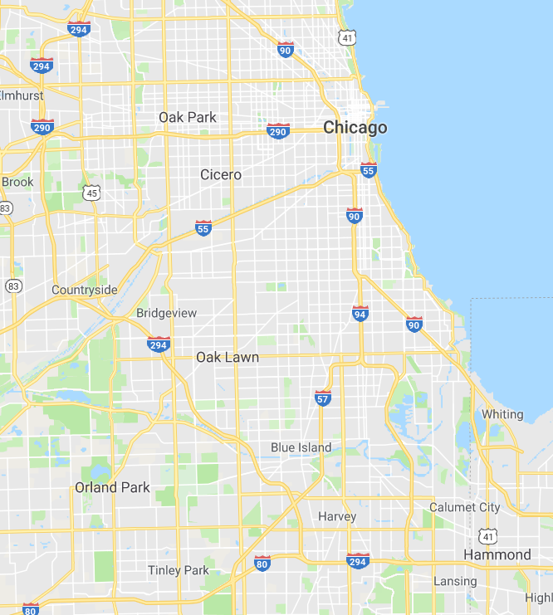
1. Introduction
Key questions:
How many autonomous vehicles do we need?
How many passengers can we serve?
How to capture the new traffic congestion?
What is the best vehicle routing and vehicle-to-passenger assignment solution?

Slide 9
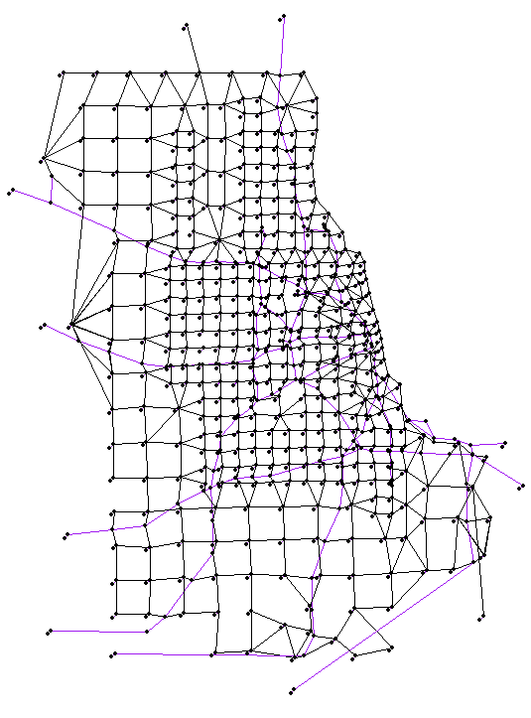
1. Introduction
# of nodes | 1320
# of links | 5431
optimization time horizon (min) | 60
arc capacity each min (vehicle) | 35
# of passenger groups with same OD and departure time | 2226
Total trip requests | 4452
# of vehicle depots | 243
Chicago Sketch Network

Slide 10
2. Key Elements
Link Capacity
Without link capacity:
Total cost is 6
With link capacity:
Total cost is 15

Slide 11
2. Key Elements
System Optimal Coordination
Without coordination (selfish routing):
Total cost is 15
With coordination:
Total cost is 9

Slide 12
2. Key Elements
Time windows
Total cost is 9
The red vehicle can wait until time 3 to pick up passenger 2, so the blue vehicle can pick up passenger 1 at exact time 3.
The optimal result doesn’t only optimize the vehicle routing, but also the departure time of picked up passengers.

Slide 13
2. Key Elements
Ridesharing (vehicle carrying capacity)
Total cost is 4
When the red vehicle’s carrying capacity is increased to 2, the total cost is reduced to 4 from 9;
Only the red vehicle is required to serve the trip requests.

Slide 14
3. Space-time-state network and model formulation
Passenger trip requests: pickup and drop-off locations and time windows
Add virtual pick-up and drop-off nodes and links for each passenger

Slide 15
3. Space-time-state network and model formulation
Time-extended Space-time network construction for physical path $1→2→4→6$
Arc (i,j,t,s) with capacity
Vertex (i,t), (j,s)
Passenger pickup time windows and locations are embedded in this network
Space-time network

Slide 16



3. Space-time-state network and model formulation
Vehicle Carrying States for passenger pickup and drop-off:
which passengers are being carried by this vehicle:
To record the passenger service status:
0: the passenger is not served;
1: under served (picked up but not delivered);
2: finished (delivered)
Example: In the case: if vehicle capacity is 1 and 2 passengers trip requests,
All possible states: [ ], [1[1]], [1[2]], [2[1]] or [2[2]]

Slide 17
3. Space-time-state network and model formulation
Vehicle State Transition with specific pickup and drop-off locations within time windows
Vehicle carrying state transition graph

Slide 18
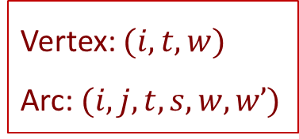
3. Space-time-state network and model formulation
One possible vehicle trajectory in a space-time-state network
state
Vertex: $(i,t,w)$
Arc: $(i,j,t,s,w,w’)$
time
space

Slide 19
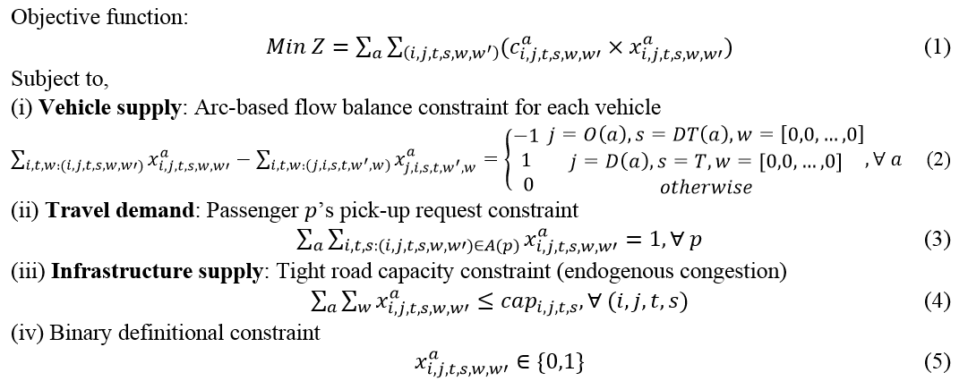
3. Space-time-state network and model formulation
Arc-based agent-based formulation:
Remark: state definition w differs for passenger pickup only and passenger pickup and drop-off

Slide 20
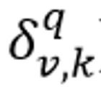
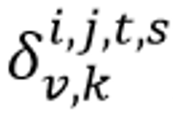
3. Space-time-state network and model formulation
Path-based flow-based formulation:
Assumptions:
(1) Vehicles and Passengers can be grouped by its origin, destination and required service time period
(2) All possible paths of vehicle groups can be enumerated in advance.
(3) The space-time-state path of each vehicle group has the mapping information about vehicle-to-passenger and vehicle-to-arc relation.
Pick up passenger 2
Drop off passenger 2
Space-time arc

Slide 21
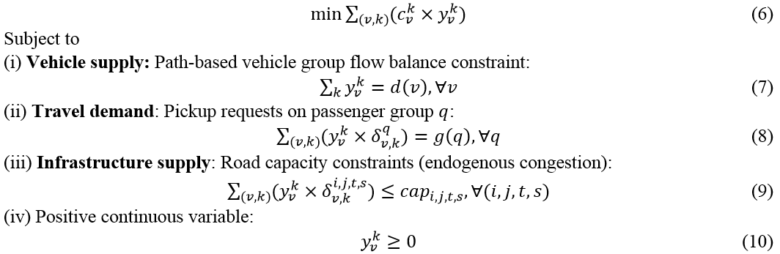
3. Space-time-state network and model formulation
Path-based flow-based formulation:

Slide 22
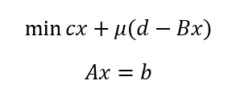
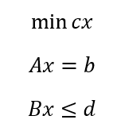
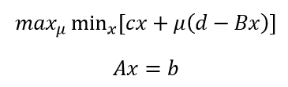
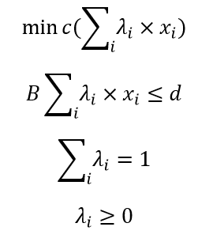
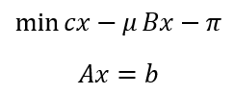
3. Space-time-state network and model formulation
Simplified format of our models
2. Lagrangian Relaxation
1. Primal problem
3. Cutting plan method
4. Column generation/DW
Flow-balance constraint
5. Augmented Lagrangian
Coupling constraint (trip request, link capacity)
Restricted master problem
Subproblems

Slide 23
4. Dantzig-Wolfe Decomposition
Objective function
Flow-balance constraint for each vehicle
Coupling constraints (passenger pickup, road capacity)

Slide 24
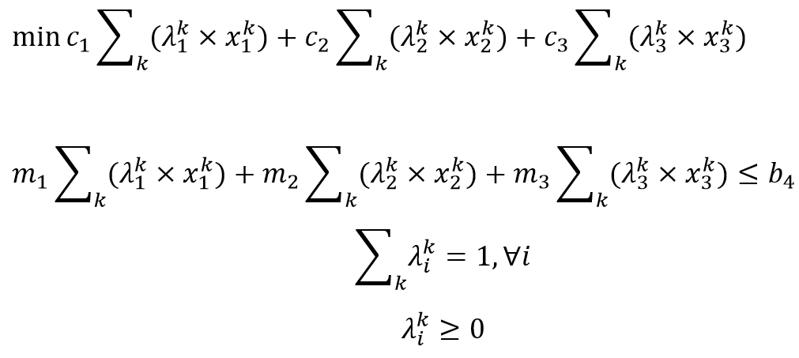
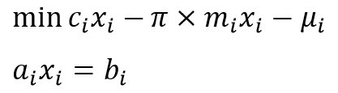
4. Dantzig-Wolfe Decomposition
Restricted Master Problem
Sub-Problems

Slide 25
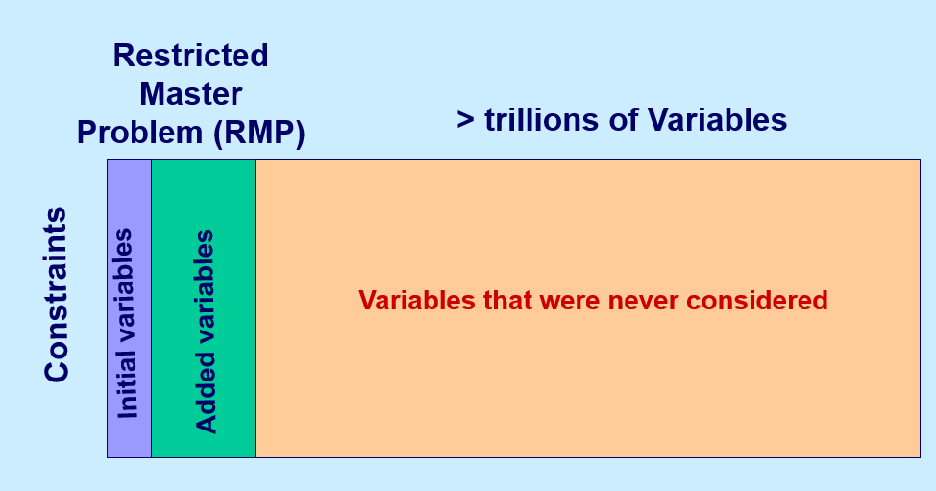
4. Dantzig-Wolfe Decomposition
https://ocw.mit.edu/courses/sloan-school-of-management/15-082j-network-optimization-fall-2010/lecture-notes/

Slide 26
4. Dantzig-Wolfe Decomposition

Slide 27
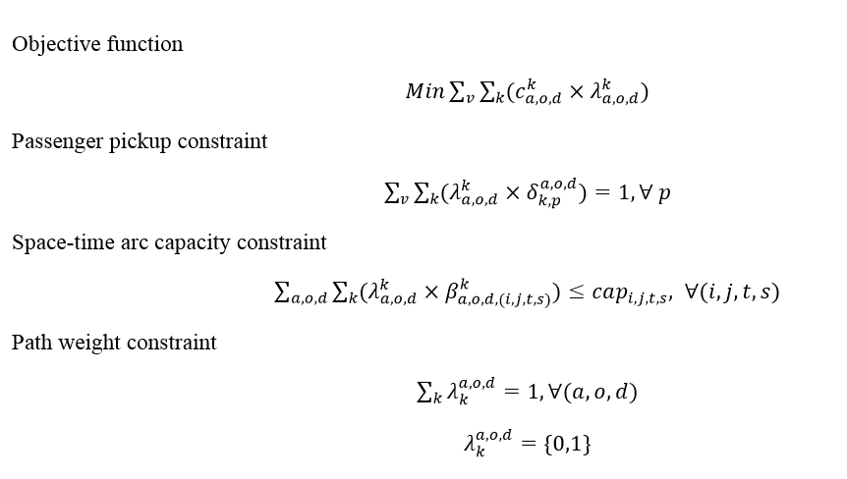
4. Dantzig-Wolfe Decomposition
Restricted master problem

Slide 28
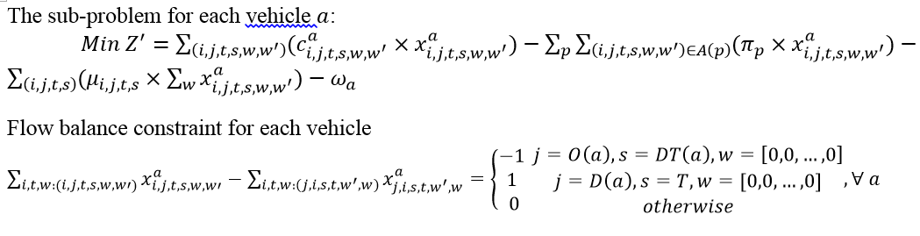
4. Dantzig-Wolfe Decomposition
Subproblems (TDSDSP)
Dual price of of passenger pickup constraints
Dual price of congestion constraints
Dual price of path weight constraints

Slide 29
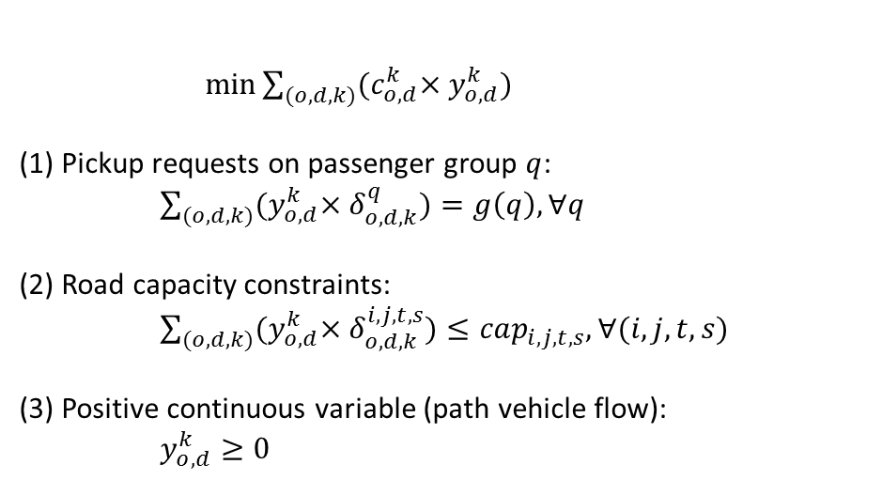
5. Column-pool based Approximation
Each column is a path with information and connection of passenger trip requests, and vehicle passed space-time arcs
$\min{\sum_{(o,d,k)}{{(c}_{o,d}^{k}×y_{o,d}^{k})}}$
(1) Pickup requests on passenger group $q$:
$\sum_{(o,d,k)}{{(y}_{o,d}^{k}×δ_{o,d,k}^{q})=g\left(q\right),∀q}$
(2) Road capacity constraints:
$\sum_{(o,d,k)}{{(y}_{o,d}^{k}×δ_{o,d,k}^{i,j,t,s})≤cap_{i,j,t,s},∀(i,j,t,s)}$
(3) Positive continuous variable (path vehicle flow):
$y_{o,d}^{k}≥0$
Compared with arc-based formulation, column-based model greatly reduces the number of variables.

Slide 30
5. Column-pool based Approximation
Incidence matrix of column with passenger trip requests
Column\ trip requests | p1 | p2 | p3 | p4
y1 | 1 | 1 | 0 | 0
y2 | 0 | 1 | 0 | 1
y3 | 0 | 0 | 1 | 1
Incidence matrix of column with arc
Column\space-time arc | arc 1(i,j,t,s) | arc 2(i,j,t,s) | arc 3(i,j,t,s) | arc 4(i,j,t,s)
y1 | 1 | 0 | 0 | 1
y2 | 0 | 1 | 1 | 0
y3 | 1 | 0 | 0 | 1

Slide 31
5. Column-pool based Approximation

Slide 32
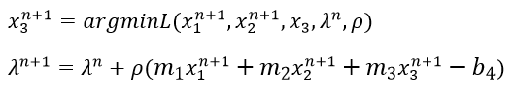
5. Column-pool based Approximation
Alternating Direction Method of Multipliers (ADMM)
Objective function:
Solutions:
Multiplier update:

Slide 33
5. Column-pool based Approximation
Sequentially solving each subproblem

Slide 34
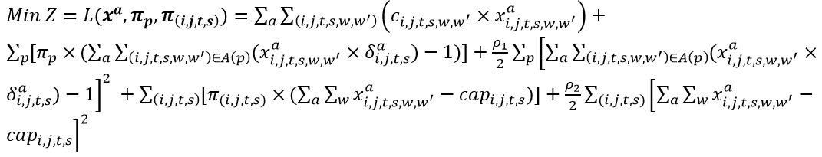
5. Column-pool based Approximation
Arc-based Agent-based formulation
Objective function:
At each iteration:
Solve each sub-problem sequentially for each vehicle
Each sub-problem is a time-dependent state-dependent shortest path problem for each vehicle
Update Lagrangian multipliers for passenger pickup constraints and arc capacity constraints

Slide 35
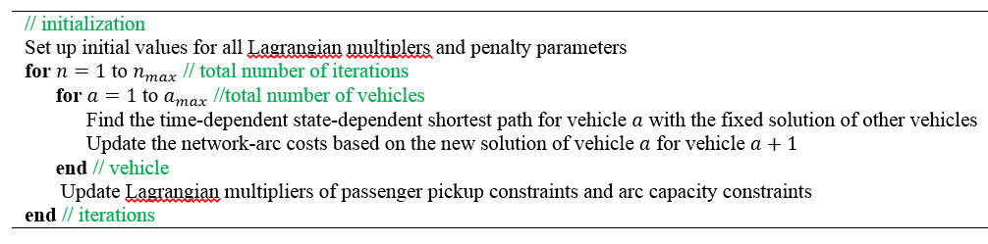
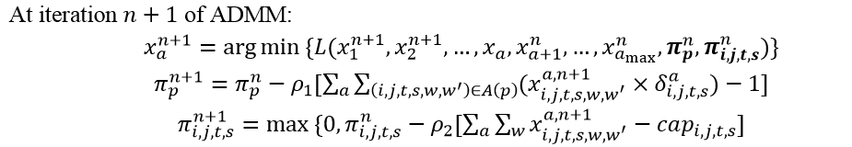
5. Column-pool based Approximation
ADMM for agent-based model

Slide 36
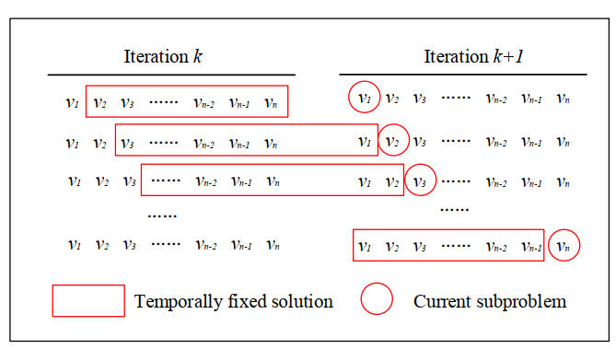
5. Column-pool based Approximation
At each iteration for each vehicle:

Slide 37
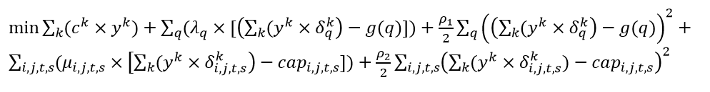
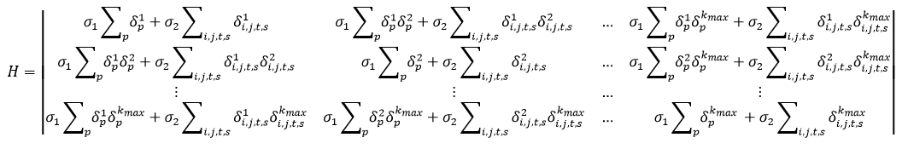
5. Column-pool based Approximation
Flow-based path-based ADMM:
Quadratic objective functions:
Its Hessian Matrix can be derived as,
Since it is difficult to directly obtain its inverse matrix $H^{−}$, especially in large-scale networks, we apply ADMM to decompose the primal problem to sequentially solve the subproblem for each column.

Slide 38
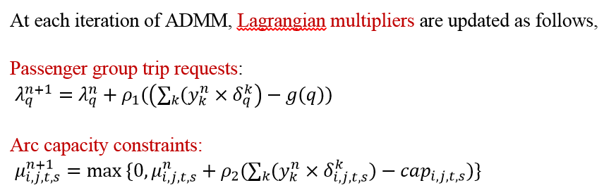
5. Column-pool based Approximation
Flow-based path-based ADMM:
Solve each variable $y_{o,d}^{k}$ sequentially by ADMM

Slide 39
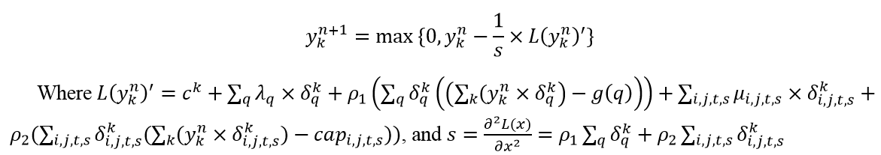
5. Column-pool based Approximation
Projected Gradient Method (Rosen, 1960) to solve each subproblem
Projected Gradient Method has been used in solving the path-based nonlinear programming models in equilibrium traffic assignment ( Larsson and Patriksson, 1992; Jayakrishnan et al, 1994; Florian et al., 2009), and it is more efficient, compared with arc-based nonlinear programming models, but needs more memory use.

Slide 40
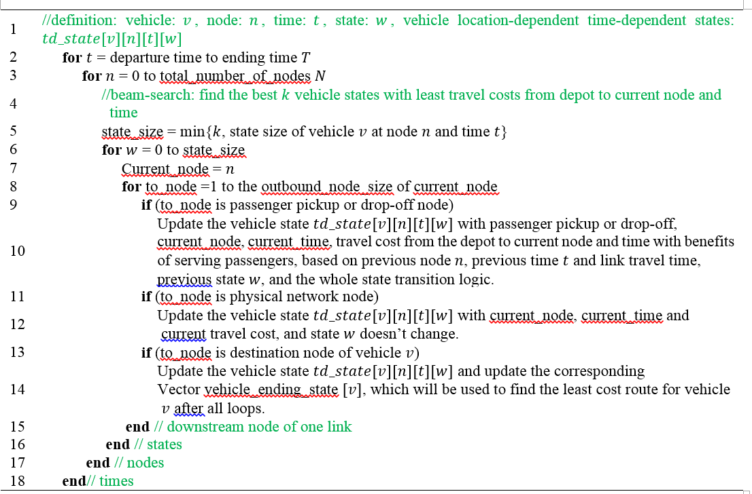
5. Column-pool based Approximation
Beam-search algorithm for finding the time-dependent state-dependent shortest paths:

Slide 41
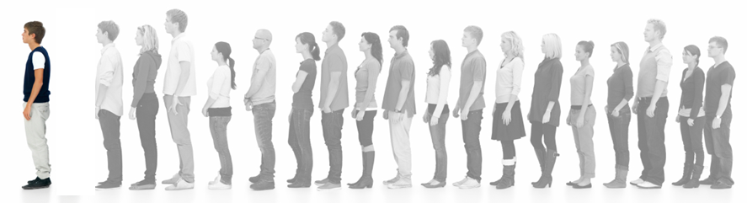

6. Discussion and Preliminary Experiments
Discussion: path marginal cost calculation
System-impact of adjusting one vehicle routing:
System marginal vehicle travel cost
System marginal passenger service benefit/cost
[Time window]
[Time window]
In this queuing system:
Waiting time for individual: 4 min
After adding one more person in the queue:
Societal travel time: additional 4 min for each person behind: +16 min, and the waiting time of added person is 4 min, so the system marginal waiting time is 20 min.
Societal service benefit: some persons may not be served in their preferred time window and it decreases the service benefit.

Slide 42
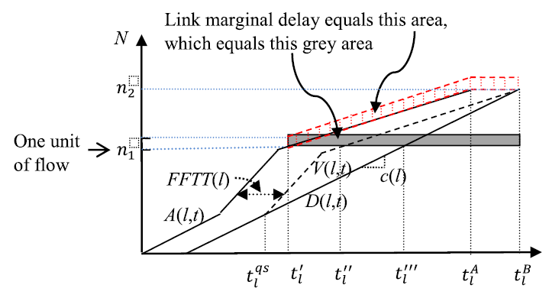
6. Discussion and Preliminary Experiments
Marginal cost calculation in system optimal dynamic traffic assignment (SODTA)
Ghali and Smith (1995)
Ghali, M.O. and Smith, M.J., 1995. A model for the dynamic system optimum traffic assignment problem. Transportation Research Part B: Methodological, 29(3), pp.155-170.

Slide 43
6. Discussion and Preliminary Experiments
Step 1: Build virtual pickup and drop-off links in physical traffic networks, and its service pricing is converted to generalized link travel cost
Step 2: find one initial solution as the input
Step 3: Perform network loading within a space-time-state network
3.1 use cumulative arrival and departure counts to derive the link marginal travel cost.
3.2 update the marginal service link benefit of passengers (not served or served by multiple vehicles)
Step 4: find the new least-marginal-cost route for each vehicles, and go to step 3; otherwise, stop.
Path marginal cost is probably related to the Lagrangian multipliers in ADMM and the dual prices in Dantzig-Wolfe decomposition.

Slide 44
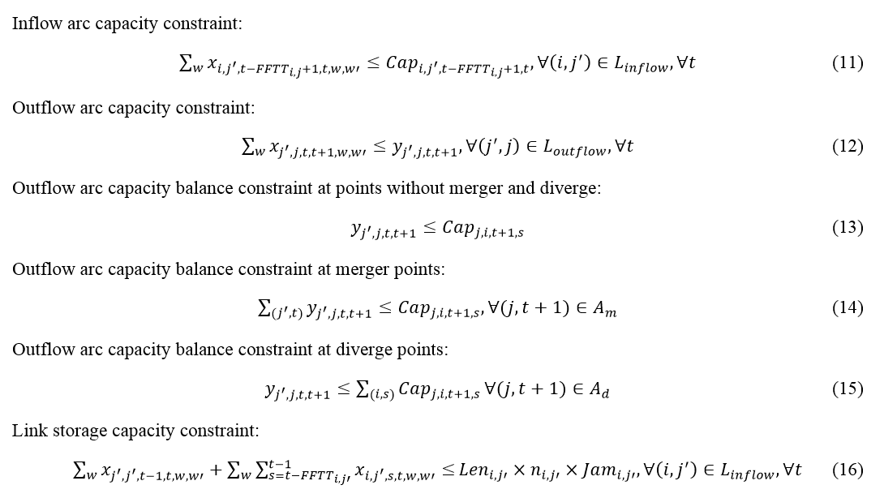
6. Discussion and Preliminary Experiments
Capture queue spillback:

Slide 45
6. Discussion and Preliminary Experiments
There are 2 vehicles, and each vehicle picks up one passenger from origin node 1 to destination node 4.
Our goal is to minimize the total vehicle travel cost by using Dantzig-Wolfe decomposition approach.

Slide 46
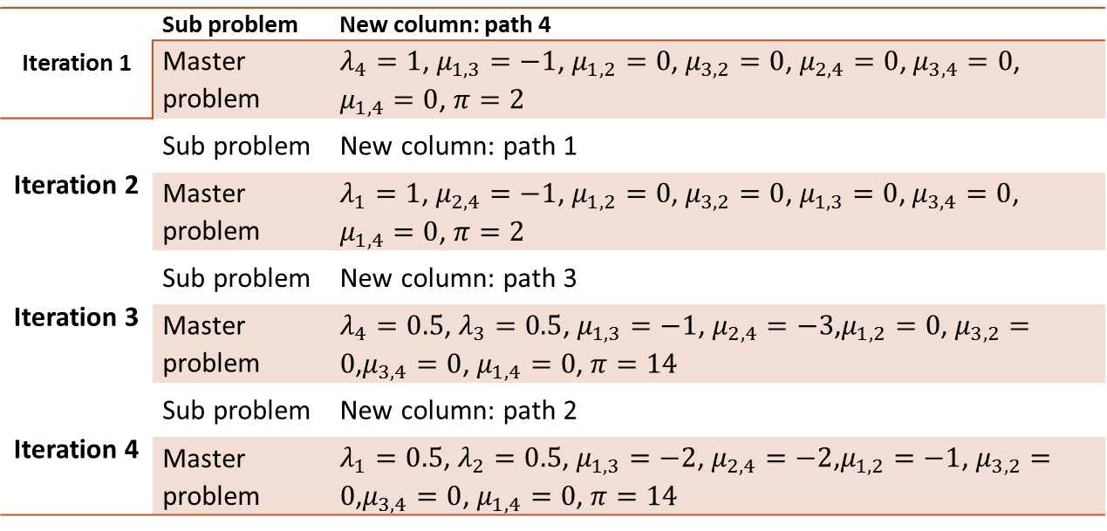
6. Discussion and Preliminary Experiments
Variable $λ_{i}$ is the weight of path $i$ of total demand; $μ_{i,j}$ is the dual price of capacity constraint of link $(i,j)$; $π$ is the dual price of path flow weight constraint.
Iteration 1 | Sub problem | New column: path 4
 | Master problem | $λ_{4}=1$, $μ_{1,3}=−1$, $μ_{1,2}=0$, $μ_{3,2}=0$, $μ_{2,4}=0$, $μ_{3,4}=0$, $μ_{1,4}=0$, $π=2$
Iteration 2 | Sub problem | New column: path 1
 | Master problem | $λ_{1}=1$, $μ_{2,4}=−1$, $μ_{1,2}=0$, $μ_{3,2}=0$, $μ_{1,3}=0$, $μ_{3,4}=0$, $μ_{1,4}=0$, $π=2$
Iteration 3 | Sub problem | New column: path 3
 | Master problem | $λ_{4}=0.5$, $λ_{3}=0.5$, $μ_{1,3}=−1$, $μ_{2,4}=−3$,$μ_{1,2}=0$, $μ_{3,2}=0$,$μ_{3,4}=0$, $μ_{1,4}=0$, $π=14$
Iteration 4 | Sub problem | New column: path 2
 | Master problem | $λ_{1}=0.5$, $λ_{2}=0.5$, $μ_{1,3}=−2$, $μ_{2,4}=−2$,$μ_{1,2}=−1$, $μ_{3,2}=0$,$μ_{3,4}=0$, $μ_{1,4}=0$, $π=14$
The reduced cost is $4+5−\left(−2\right)−\left(−2\right)−\left(−1\right)−14=0$ and reach the optimal solution.

Slide 47
6. Discussion and Preliminary Experiments
Requests with pickup and drop-off and time windows under capacitated networks
# of nodes | 24
# of links | 84
# of trip requests (pickup and drop-off with time windows) | 30
# of available autonomous vehicles | 30
# of depots | 5
optimization time horizon (time unit) | 110
Vehicle capacity (person) | 1
Sioux Falls Network
Source code: https://github.com/TonyLiu2015/VRPLite-DW

Slide 48
6. Discussion and Preliminary Experiments
Initial feasible solution
Vehicle_No | Passenger_No | Vehicle_No | Passenger_No | Vehicle_No | Passenger_No
1 | [15] | 11 | [20] | 21 | [23]
2 | [8] | 12 | [26] | 22 | [25]
3 | [1] | 13 | [16] | 23 | [22]
4 | [7] | 14 | [18] | 24 | [19]
5 | [9] | 15 | [2] | 25 | [4]
6 | [11] | 16 | [10] | 26 | [5]
7 | [29] | 17 | [3] | 27 | [24]
8 | [28] | 18 | [12] | 28 | [14]
9 | [17] | 19 | [27] | 29 | [13]
10 | [21] | 20 | [30] | 30 | [6]

Slide 49
6. Discussion and Preliminary Experiments
Dantzig-Wolfe decomposition algorithm solution:
Each passenger has specific pickup and drop-off location and time windows
The vehicle benefit of serving one passenger is 20
The vehicle waiting cost is the half of the waiting time
 | Number of required vehicles | Total travel cost
Initial solution | 30 | 1096
vehicle carrying capacity is 1 | 27 | 967.5
vehicle carrying capacity is 2 | 25 | 869.5
Take vehicle 9 as an example:
In initial solution: picks up passenger 17 -> drops off passenger 17;
Vehicle carrying capacity is 1: picks up passenger 17 -> drops off passenger 17-> picks up passenger 29 -> drops off passenger 29
Vehicle carrying capacity is 2: picks up passenger 17 -> drops off passenger 17-> picks up passenger 30-> picks up passenger 29-> drops off passenger 29-> drops off passenger 30

Slide 50
6. Discussion and Preliminary Experiments
Requests with pickup only and time windows under capacitated networks
# of nodes | 1320
# of links | 5431
optimization time horizon (time unit) | 60
Chicago network

Slide 51
6. Discussion and Preliminary Experiments
Step A: Prior generation of column pool
Scenario 1: Sample data set
10 pairs of vehicle groups and passenger groups.
Each pair has 243 vehicles and 387 passengers trip requests
The space-time arc capacity in each minute is 5.
Vehicle carrying capacity is 1
2430 binary variables and 332,160 constraints
Scenario 2: Sample data set
20 pair of vehicle groups and passengers groups.
Each pair has 243 vehicles and 387 passengers trip requests
The space-time arc capacity in each minute is 5.
Vehicle carrying capacity is 1
4860 binary variables and 338,460 constraints

Slide 52
6. Discussion and Preliminary Experiments
Solution from Agent-based ADMM
Scenario 1:
1789 vehicles find their paths/columns to serve 1084 passengers
23,357 space-time arcs are generated based on vehicles’ space-time paths
Computation time: about 70 seconds each iteration
Scenario 2:
3686 vehicles find their paths/columns to serve 2226 passengers
36,454 space-time arcs are generated based on vehicles’ space-time paths
Computation time: about 140 seconds each iteration
Remark: each passenger has a specific pickup location, time window and destination, and vehicle can only pick up passengers within a same pair of groups.

Slide 53
6. Discussion and Preliminary Experiments
Step B: Flow-based ADMM implemented by C++
Experiment 1:
1084 passenger groups and each passenger group has 4 passenger trip requests
The space-time arc capacity in each minute is 35
1789 positive continuous variables and 24,441 constraints
Computation time: 700 CPU seconds for running 250 iterations
Experiment 2:
2226 passenger groups and each passenger group has 2 passenger trip requests
The space-time arc capacity in each minute is 35
3686 positive continuous variables and 38,680 constraints
Computation time: 2735 CPU seconds to finish 250 iterations

Slide 54
6. Discussion and Preliminary Experiments
Experiment 1
Case 1: $ρ_{1}=3$ and $ρ_{2}=1$; Case 2: $ρ_{1}=3$ and $ρ_{2}=3$; Case 3: $ρ_{1}=3$ and $ρ_{2}=5$.
Solution of each iteration of ADMM in three cases and CPLEX

Slide 55
6. Discussion and Preliminary Experiments
Experiment 1
Comparison of objective values of upper bound and CPLEX

Slide 56
6. Discussion and Preliminary Experiments
Experiment 2
Visualization of congested nodes in experiment 1

Slide 57
6. Discussion and Preliminary Experiments
Experiment 2
Case 1: $ρ_{1}=3$ and $ρ_{2}=1$; Case 2: $ρ_{1}=3$ and $ρ_{2}=3$; Case 3: $ρ_{1}=3$ and $ρ_{2}=5$.
Solution of each iteration of ADMM in three cases and CPLEX

Slide 58
6. Discussion and Preliminary Experiments
Experiment 2
Case 1: $ρ_{1}=3$ and $ρ_{2}=1$; Case 2: $ρ_{1}=3$ and $ρ_{2}=3$; Case 3: $ρ_{1}=3$ and $ρ_{2}=5$.
Comparison of objective values of upper bound and CPLEX

Slide 59
6. Discussion and Preliminary Experiments
Experiment 2
Visualization of congested nodes in experiment 2

Slide 60
7. Summary
Required knowledge:
Dynamic Traffic Assignment and Vehicle Routing Problem
Space-time-state network construction and network flow model
Time-dependent State-dependent shortest path problem
Dantzig-Wolfe decomposition algorithm
, ADMM and Projected Gradient method

Slide 61
References
Space-time-state network flow models and vehicle routing problem:
1. Mahmoudi, M. and Zhou, X., 2016. Finding optimal solutions for vehicle routing problem with pickup and delivery services with time windows: A dynamic programming approach based on state–space–time network representations. Transportation Research Part B: Methodological, 89, 19-42.
2. Liu, J., Kang, J., Zhou, X., Pendyala, R., 2018. Network-oriented household activity pattern problem for system optimization. Transportation Research Part C 94, 250-269
3. Zhou, X., Tong, L., Mahmoudi, M., Zhuge, L., Yao, Y., Zhang, Y., Shang, P., Liu, J. and Shi, T., 2018. Open-source VRPLite Package for Vehicle Routing with Pickup and Delivery: A Path Finding Engine for Scheduled Transportation Systems. Urban Rail Transit, 4(2), 68-85.
Dynamic Traffic Assignment and Traffic flow model:
4. Lu, C.C., Liu, J., Qu, Y., Peeta, S., Rouphail, N.M. and Zhou, X., 2016. Eco-system optimal time-dependent flow assignment in a congested network. Transportation Research Part B: Methodological, 94, pp.217-239.
5. Zhou, X. and Taylor, J., 2014. DTALite: A queue-based mesoscopic traffic simulator for fast model evaluation and calibration. Cogent Engineering, 1(1), p.961345.
Dantzig-Wolfe Decomposition algorithm
6. https://en.wikipedia.org/wiki/Dantzig%E2%80%93Wolfe_decomposition
Alternating Direction Method of Multipliers (ADMM)
7. https://web.stanford.edu/~boyd/papers/pdf/admm_slides.pdf

Slide 62


